Slide 1
M110: Python Programming Self-Study#1 Turtle Graphics
Prepared by Dr. Ahmad Mikati

Slide 2
Content
Introduction to Turtle Graphics
Determining the State of the Turtle
Problem solving using decomposition
Using Loops to Draw Designs
Drawing a line graph
Programming the turtle using nested loops

Slide 3
Introduction
Turtle graphics is an interesting and easy way to learn basic programming concepts. The Python turtle graphics system simulates a “turtle” that obeys commands to draw simple graphics.
This turtle can be instructed to move around a two-dimensional space, leaving a trace of its movement using a coloured pen.
This provides a lot of opportunities for drawing interesting shapes, diagrams and indeed pictures.

Slide 4
Turtle Graphics
The first step in using Python’s turtle graphics system is to write the following statement:
import turtle
This statement is necessary because the turtle graphics system is not built into the Python interpreter.
Instead, it is stored in a file known as the turtle module. The import turtle statement loads the turtle module into memory so the Python interpreter can use it.
If you are writing a Python program that uses turtle graphics, you will write the import statement at the top of the program.

Slide 5
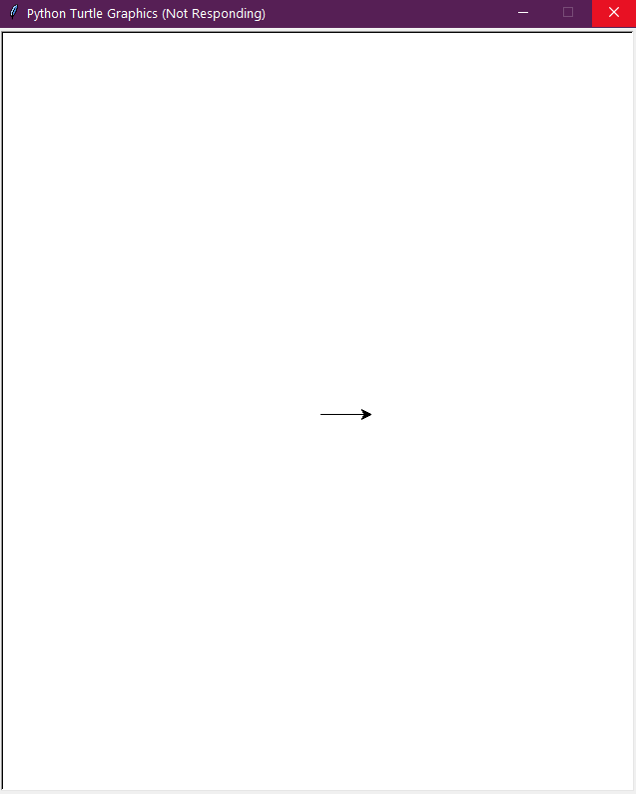
Drawing Lines with the Turtle
The Python turtle is initially positioned in the center of a graphics window that serves as its canvas. If we instruct the turtle to move forward, it will move in the direction that the arrowhead is pointing.
You can use the turtle.forward(n) command to move the turtle forward n pixels.
N.B: in order to avoid writing turtle. before each command, you can use from turtle import * instead of import turtle at the beginning of your program. Also, you can use an alias name; for example: import turtle as t . The same applies to other packages/modules.
import turtle
turtle.forward(50)
OR
from turtle import *
forward(50)
OR
import turtle as t
t.forward(50)

Slide 6
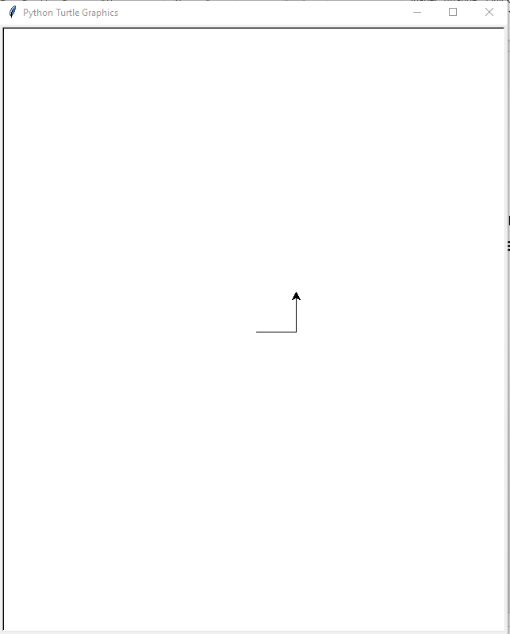
Turning the Turtle
When the turtle first appears, its default heading is 0 degrees (heading to the right).
You can turn the turtle, so it faces a different direction by using either the right(angle) command, or the left(angle) command.
from turtle import *
forward(50)
left(90)
forward(50)

Slide 7
Programming using turtle
Here is our simple turtle program. (You can try these commands in Python and see what happens.)
# Draw start of staircase
from turtle import *
forward(40)
left(90)
forward(40)
right(90)
forward(40)
Comment “no execution“
the line is stating that we will be working with commands that apply to a turtle
The operation that have been available for us to use on turtle
forward(40) : The operation works in terms of pixels. As the turtle always starts pointing horizontally to the right, so this line results in the turtle drawing a horizontal line from left to right of length 40 units.

Slide 8
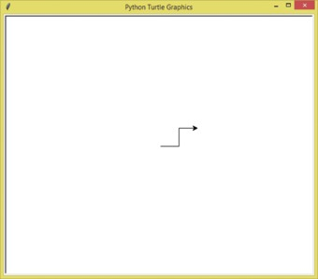
Programming using turtle
The program draws the start of a staircase consisting of three lines.
Note that the figure includes an arrowhead representing the turtle.
For our purposes it is sometimes useful to see where the turtle is and where it is pointing. This is partly because some of our solutions will be used as part of larger solutions.
Hiding and Displaying the Turtle
If you don’t want the turtle to be displayed, you can use the hideturtle() or ht() command to hide it.
If you want the turtle to be displayed, you can use the showturtle() or st() command to display it.

Slide 9
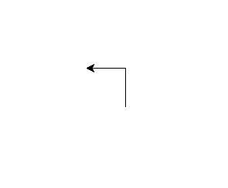

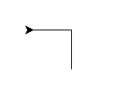

Programming using turtle
Getting the Turtle’s Current Heading
You can use the heading() command to display the turtle’s current heading.
You can use the setheading(angle) command to set the turtle’s current heading to that angle.

Slide 10
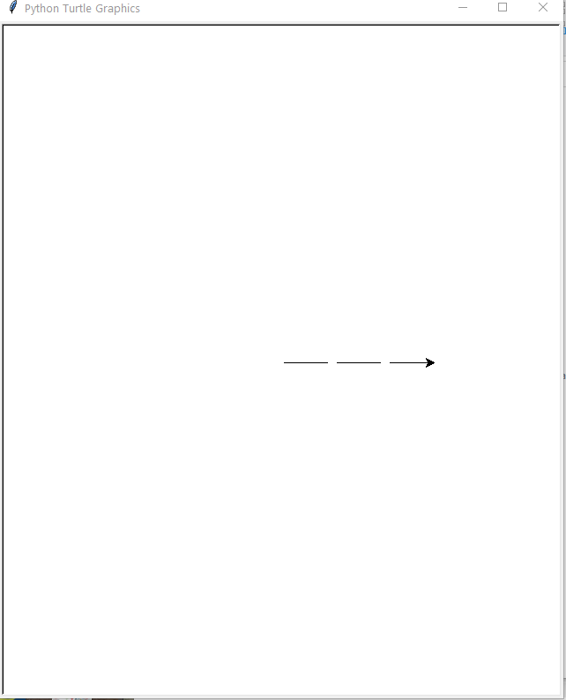

Programming using turtle
Moving the Pen Up and Down
In Python, you can use the penup() or pu() command to raise the pen, and the
pendown() or pd() command to lower the pen.
When the pen is up, you can move the turtle without drawing a line.
When the pen is down, the turtle leaves a line when it is moved. (By default, the pen is down.)
Consider the below program:
from turtle import *
forward(50)
pu()
forward(10)
pd()
forward(50)
pu()
forward(10)
pd()
forward(50)

Slide 11
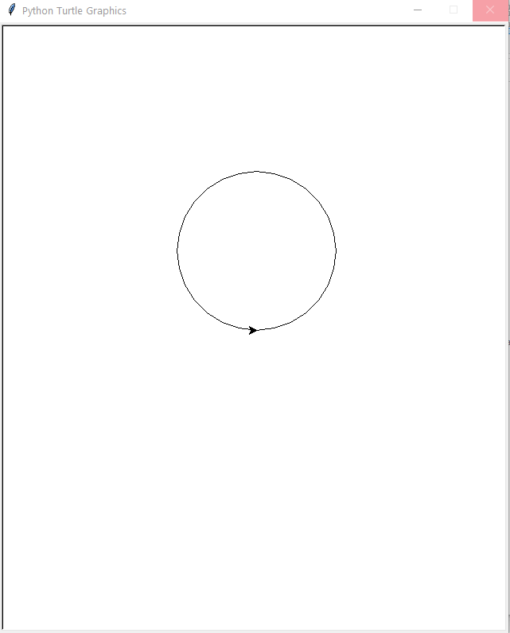
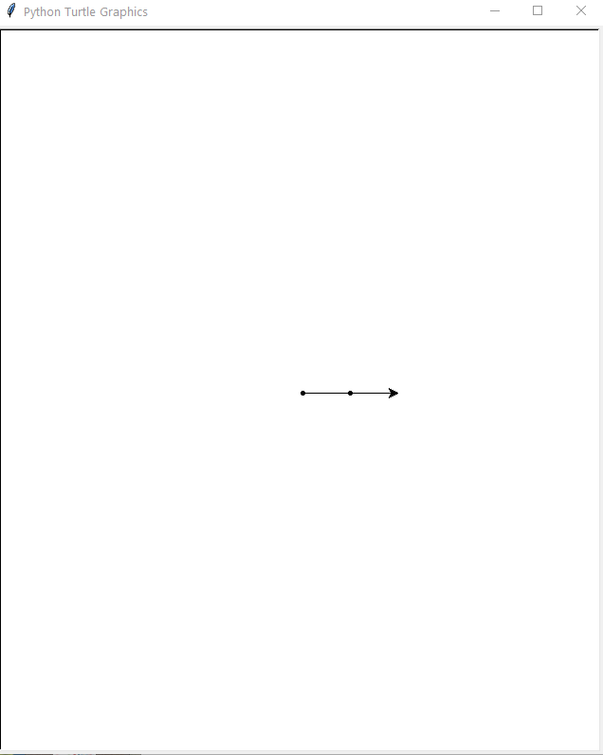
Programming using turtle
Drawing Circles and Dots
In Python, you can use the circle(radius value) command to make the turtle draw a circle with a radius pixels.
You can use the dot() command to make the turtle draw a simple dot.
Consider the below programs:
clear() # to clear the canvas
pu()
setpos(0,0) # to set the starting point
pd()
circle(100)
clear() # to clear the canvas
pu()
setpos(0,0) # to set the starting point
pd()
dot()
forward(50)
dot()
forward(50)

Slide 12
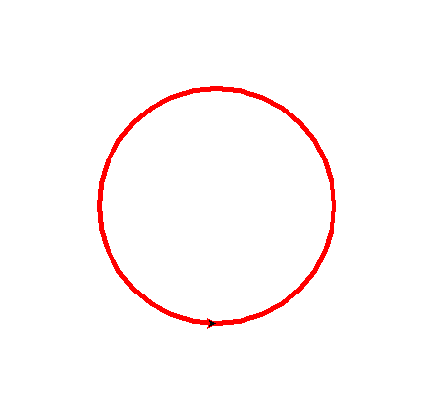
Programming using turtle
Changing the Pen Size
In Python, you can use the pensize(width) command to change the width of the turtle’s pen, in pixels. The width argument is an integer specifying the pen’s width.
Changing the Drawing Color
In Python, you can use the pencolor(color) command to change the turtle’s drawing color. The color argument is the name of a color, as a string.
For example, pencolor(‘red’)
import turtle as t
t.pensize(5)
t.pencolor('red')
t.circle(120)

Slide 13
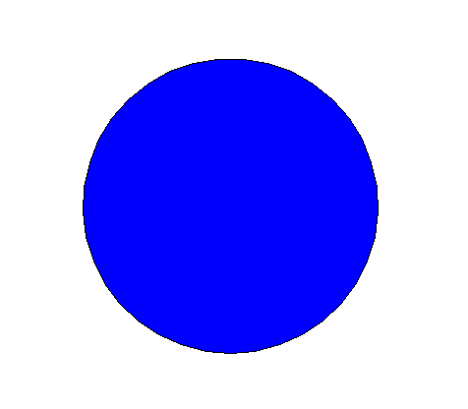
Programming using turtle
Filling Shapes
In Python, if you want to fill a shape with a color, you use the begin_fill() command before drawing the shape, then you use the end_fill() command after the shape is drawn. You can change the fill color with the fillcolor(color) command.
from turtle import *
reset()
ht()
fillcolor('blue')
begin_fill()
circle(150)
end_fill()
Setting the window's background color.
To set the window's background color, you use the turtle.bgcolor(color) command.

Slide 14
Programming using turtle
Clearing the Screen
In Python, you can use the clear() command to erase all drawings that currently appear in the graphics window but neither change the drawing color nor change the turtle position in the center of the screen.
Resetting the Screen
In Python, you can use the reset() command to erase all drawings that currently appear in the graphics window, and reset the drawing color to black, and reset the turtle to its original position in the center of the screen.
clear() # to clear the canvas
pu()
setpos(0,0) # to set the starting point
pd()
reset() # to clear the canvas, and
# to reset to the original position
Note that both commands will not reset the graphics window’s background color to white. To do that, you should use clearscreen(), which does the same as reset() plus clearing the window’s background.

Slide 15
Programming using turtle
Specifying the Size of the Graphics Window
In Python, you can use the setup(width, height) command to specify a size for the graphics window. The width and height arguments are the width and height, in pixels.
Displaying Text in the Graphics Window
In Python, you can use the write(text) command to display text in the graphics window. The text argument is a string that you want to display. When the string is displayed, the lower-left corner of the first character will be positioned at the turtle’s X and Y coordinates.
Animation Speed
In Python, you can use the speed(val) command to change the speed at which the turtle moves. The val argument is a number in the range of 0 through 10. 10 is the fastest, 1 is the slowest, 0 means that the animation is disabled.
To know more about the previously explained turtle commands and many others, you can refer to the pdf file posted on your Moodle page.

Slide 16
Problem solving using decomposition Programming using turtle
If we had written the solution to the previous staircase problem in natural language (English, in our case), we might have had something like:
> Draw start of staircase
move forward by 40 units
turn left by 90 degrees
…
Our first line uses a ‘>’ symbol, which shows that the first line is a heading: ‘> Draw start of staircase’, which tells us what we want to do. It describes the problem we are solving.
The next two lines are a decomposition of the heading line above. These two lines achieve the task set out in the heading.

Slide 17
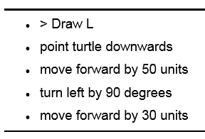
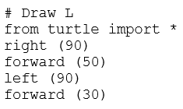
Problem solving using decomposition Drawing some simple shapes through decomposition
Natural Language
Python

Slide 18
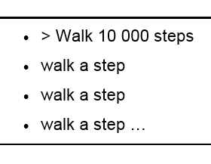
Using Loops to Draw Designs
Imagine you have decided that you need to walk 10 000 steps per day to stay fit. We start to write the algorithm:
Having realized that writing the algorithm out this way is going to be very tedious, we want a way of writing down something that repeats a number of times.

Slide 19
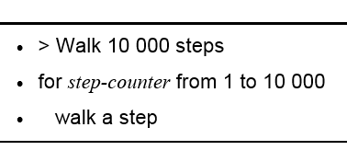
Using Loops to Draw Designs
We will have a variable called ‘step-counter’, and we need a way of giving it a value, doing something, and increasing the value. We also need to stop after 10 000.
We will use the keyword ‘for’ to show that we want to do something for a number of times. We will use it as follows:
This is an example of iteration: something gets carried out a number of times (Loop).
The idea is that we do something repeating it a number of times.

Slide 20
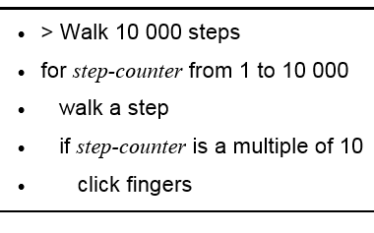
Using Loops to Draw Designs (Making choices)
Now, suppose that I want to click my fingers only when a multiple of 10 is reached. Then, I can modify my algorithm as follows:
Notice that the if keyword is indented at the same level as ‘Walk a step’ – since they are two parts of the same sequence. The click step is indented further, to show it is conditional on the condition expressed by the if statement.

Slide 21
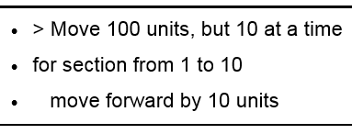
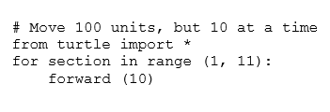
Using Loops to Draw Designs
In this case, for denotes iterating (looping) around a statement or sequence of statements.
Python
The program will move the turtle forward by 100 units. It does this by moving forward 10 units and repeating this movement ten times.
range(1, 11) means that the range of numbers starts at 1, counts upwards by 1 and stops just before 11.

Slide 22

Using Loops to Draw Designs
Python
Alternative Solution
Recall that In Python, when we specify a range using just one number, then the range starts at 0.
In this case, when using range(10), we get a range of whole numbers from 0 to 9.

Slide 23
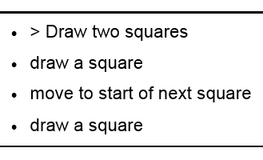
Using Loops to Draw Designs
Let’s think about a slightly more complicated problem. We will design and implement a program to draw two squares, one below the other, with a gap in between.
Problem decomposition

Slide 24
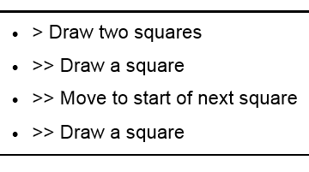
Using Loops to Draw Designs
We have now decomposed the problem into sub-problems, rather than steps.
The symbol >> refers to sub-problems

Slide 25
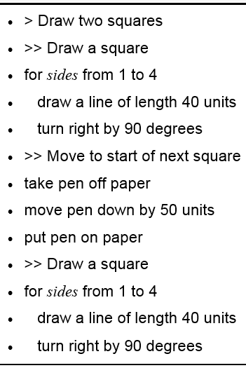
Using Loops to Draw Designs
Now we can decompose the
sub-problems into steps.
We did copy and paste from the original square algorithm! This is known as reusing solutions.
Reuse is a mature approach to program design for saving time, and avoid introducing errors

Slide 26
Drawing a graph of a fixed number of points
In this subsection, we will consider how to draw a line graph.
We will assume we are plotting the sales of gloves, by a given company, over the four quarters of the year.
Now, we have seen how a variable could be used to control a loop, and that it is essentially a named box that can hold a value.
Here we will use variables to hold the sales of gloves for each quarter.
Variables g1, g2, g3 and g4 to hold the number, in millions, of gloves sold in the first, second, third and fourth quarters.

Slide 27
Drawing a graph of a fixed number of points
The turtle has considerably more operations than we have seen so far.
In particular, it has an operation goto that allows us to move the pen to a position, drawing a line as we go.
Assume we are starting at position (0,0), the python code goto(40,0) moves the turtle horizontally to position (40,0), drawing a line if the pen is down. The first value in the brackets represents the horizontal displacement (from 0) and the second value represents the vertical displacement.

Slide 28
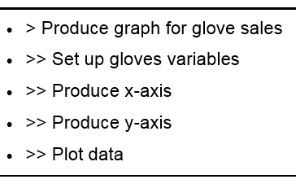

Drawing a graph of a fixed number of points
Python
# Produce graph for gloves sales
from turtle import *
# set up the variables
g1=10
g2=8
# produce the x axis
goto(40,0)
goto(0,0)
# produce the y axis
goto(0,100)
goto(0,0)
# Plot data
goto(20, g1*10)
goto(40, g2*10)
ht() # to hide the turtle prompt

Slide 29

Drawing a graph of a fixed number of points
Python
# Produce graph for gloves sales
from turtle import *
# set up the variables
reset()
g1=10
g2=8
# produce the x axis
goto(40,0)
goto(0,0)
# produce the y axis
goto(0,120)
goto(0,0)
# Plot data for 2 values
goto(20, g1*10)
dot( 5, "blue")
write("g1", False,"center","bold")
goto(40, g2*10)
dot( 5, "red")
write("g2", False,”left","bold")
ht() # to hide the turtle prompt

Slide 30
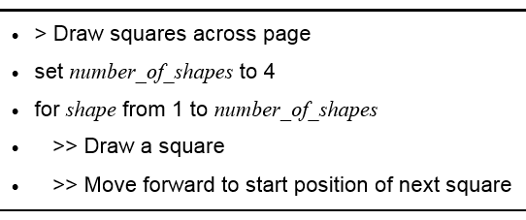
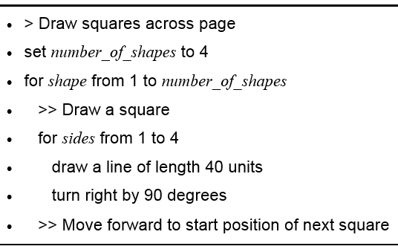
Nested iteration (Programming the turtle using nested loops)
Consider a program to produce a number of squares across the page. A decomposition of this problem is as follows:
If we now copy the decomposition from subsection for ‘Draw a square’ into the above decomposition, we get:

Slide 31
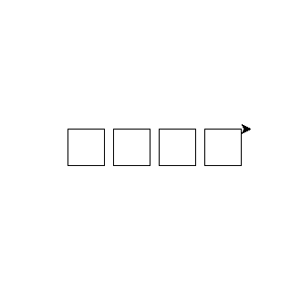
Nested iteration (nested loops)
Problem Decomposition
# Draw squares across page
from turtle import *
number_of_shapes=4
for shape in range (1, number_of_shapes +1):
for shapes in range(1,5):
forward(40)
right(90)
# Move forward to start position of next square
pu()
forward(50)
pd()
Translated Python Code

Slide 32
Modularizing Turtle Graphics Code with Functions
Commonly needed turtle graphics operations can be stored in functions
and then called whenever needed.
For example, if we need to draw a lot of blue squares, in different locations on the screen? Suddenly, we find ourselves writing similar lines of code, over and over.
We can simplify our program by writing a function that draws a square at a specified location, and then calling that function anytime we need it.
The following program demonstrates modularizing turtle graphics code with functions

Slide 33
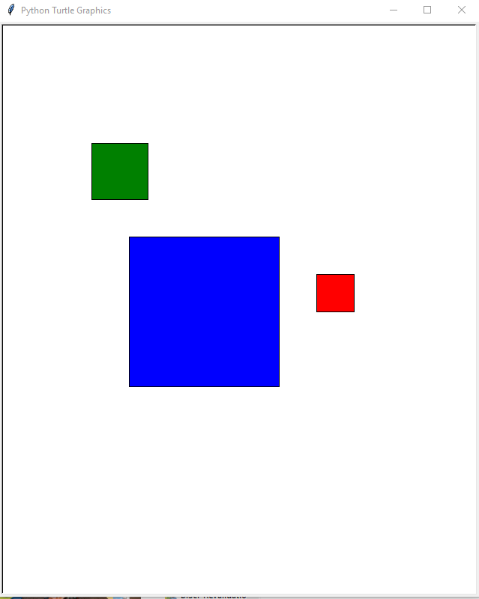
Modularizing Turtle Graphics Code with Functions
from turtle import *
def main():
reset()
ht()
square(100, 0, 50, 'red')
square(-150,-100, 200, 'blue')
square(-200,150, 75, 'green')
# The square function draws a square. The x and y parameters
# are the coordinates of the lower-left corner. The width
# parameter is the width of each side. The color parameter
# is the fill color, as a string.
def square(x, y, width, color):
pu() # Raise the pen
goto(x, y) # Move to the specified location
fillcolor(color) # Set the fill color
pd() # Lower the pen
begin_fill()
for count in range(4): # Draw a square
forward(width)
left(90)
end_fill() # End filling
# Call the main function.
main()

Slide 34
Extra Exercises

Slide 35
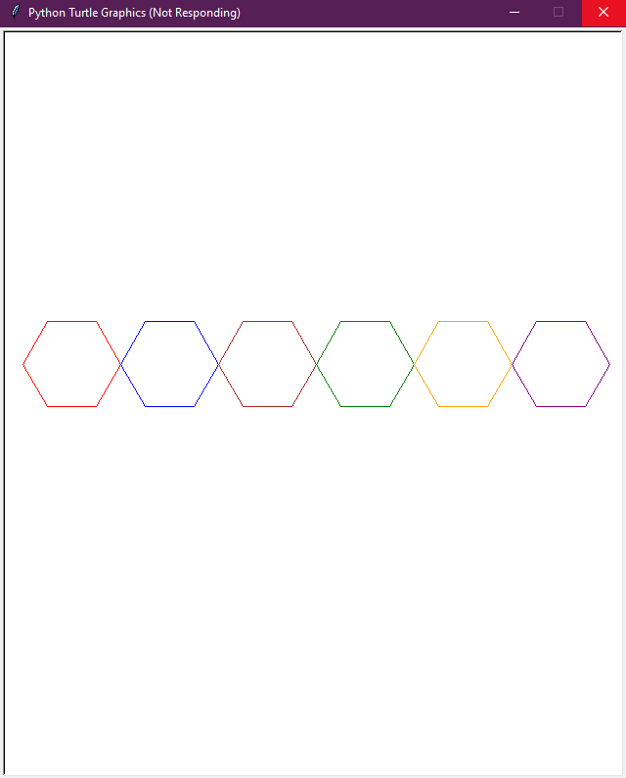
Exercise 1
Draw six Hexagons with different colors. The output should be like the below figure:

Slide 36
Exercise 1- Solution
# Draw 6 Hexagons with different colors
from turtle import *
colors=['red', 'blue', 'brown', 'green', 'orange’, 'purple']
clear()
penup()
setpos(-225,0)
pendown()
speed(10)
for i in range(6):
pencolor(colors[i])
for sides in range(6):
left(60)
forward(50)
penup()
forward (100)
pendown()
ht()

Slide 37
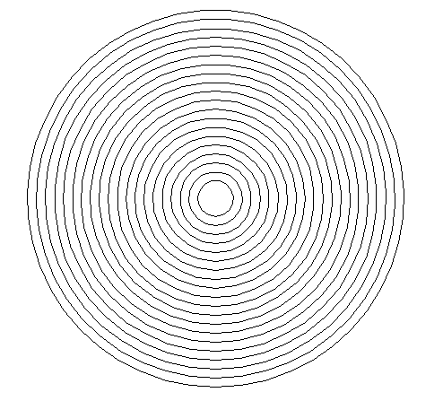
Exercise 2
Using a loop, draw the below shape. The output should be like the below figure:

Slide 38
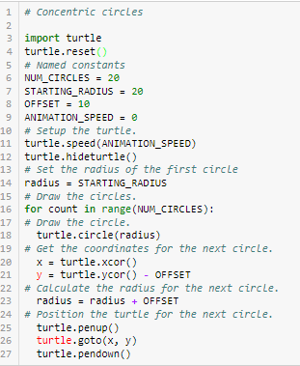
Exercise 2- Solution
Try to write a simpler code that displays the same output

Slide 39
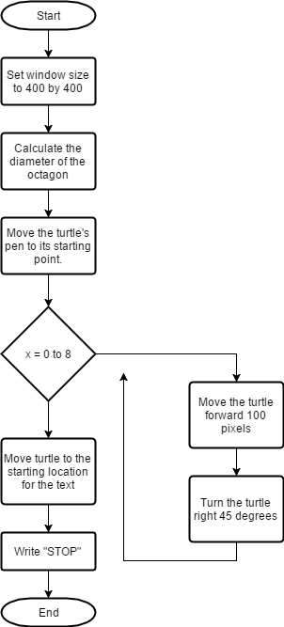
Exercise 3
Write a Python program that implements the following flowchart.
Write your own code

